Slide 1

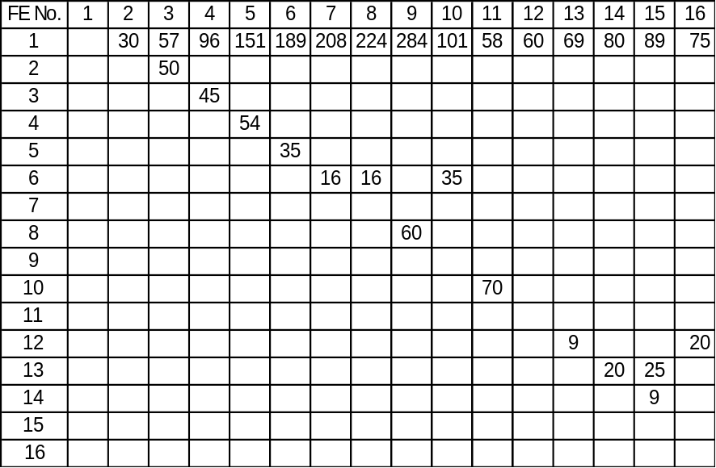



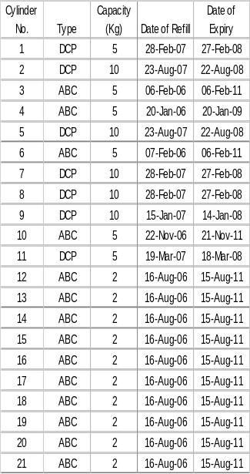
Fire Extinguisher Layout & Emergency Exit Plan
STPPL / HRA / CH / 07
Fire Extinguisher Distance Chart (FT)

REV: 01
14
15
REV. DATE: 01/02/2024.
TECHNICAL BLOCK
PAGE: 1 OF 2.
TRAINING CENTRE
LEGEND
Fire Extinguisher

Safety Hooter
Way to Emergency Exit
◉
Safety Hooter Switch
MANAGEMENT BLOCK
12
13
Staircase

Lightening Arrester
16
COMMERCIAL BLOCK
Water tank
Water taps
Main Gate
Security Cabin
◉
Despatch Office
HT Area
Small Gate

North
1
24 FT
4 Wheeler Parking
Emergency Assly Area
50 FT
2
Fire Extinguisher Details
Prod. Dept.
QA Dept.
3
Staff Toilet
2 Wheeler & Bicycle Parking
11
Finishing Area
45 FT
Printing Area
Moulding Shop
Cylinder No.7 is on First Floor
70 FT
4
Post Operation
10
Moulding Shop
54 FT
Canteen Area
7
35 FT
16 FT
6
35 FT
5
Underground Water Tank 20000 Litres
60 FT
16 FT
8
Stores
Tool Room
Cooling Tower
Grinding Room
9
Ladies Toilet
GentsToilet 1
Gents Toilet 2
Approved by
Resp: Sarvesh P. Sakale.

Slide 2
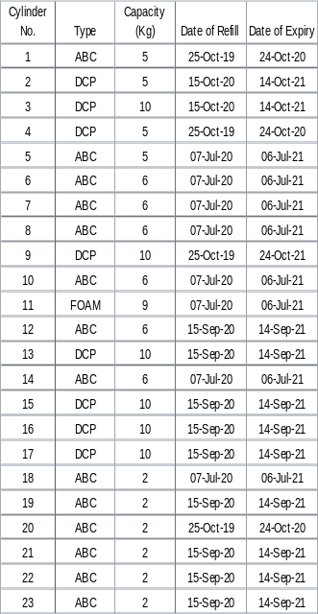
Fire Extinguisher Layout & Emergency Exit Plan
STPPL / HRA / CH / 07
Fire Extinguisher Chart

REV: 01
14
15
REV. DATE: 01/02/2024.
TECHNICAL BLOCK
PAGE: 2 OF 2.
TRAINING CENTRE
LEGEND
Fire Extinguisher

Safety Hooter
North
Way to Emergency Exit
◉
Safety Hooter Switch
MANAGEMENT BLOCK
12
13
Staircase

Lightening Arrester
16
COMMERCIAL BLOCK
Water tank
Hydraulic lift
Water taps
Fire Extinguisher Details
Main Gate
Security Cabin
◉
Dispensary
HT Area
Small Gate

1
24 FT
4 Wheeler Parking
Emergency Assly Area
50 FT
2
Dispatch Office
Prod. Dept.
HR Dept.
Tool Room
3
Staff Toilet
2 Wheeler & Bicycle Parking
11
FG material Storage area
45 FT
QA Dept.
Moulding Shop
FG Material Storage area
70 FT
4
Cylinder No.7 is on First Floor
Canteen Area
10
Moulding Shop
54 FT
7
FG Material Storage area
35 FT
16 FT
6
35 FT
5
Underground Water Tank 20000 Litres
60 FT
16 FT
Water pump
Underground Water Tank 20000 Litres
8
Stores
Material storage area
Annealimg Tank
Grinding Room
9
Firewall
Ladies Toilet
Maintenance Office
Ladies Toilet
Cooling Tower
Approved by
ORA
Hot insertion
Deflashing area
Pad Printing

